Slide 1

Platform for Subletting Apartments
Start looking for you new adventure!
SubNet
Github: https://github.com/IlanSimchon/SubNet

Slide 2


Our Team
Ilan Simchon
212036396
Chen Lipschitz
207270612
Ohad Volfman
316552496
Alon Suisa
DB- Back
Server- Back
Apartment page– add apartment, rating and recommendations
House owner page- adding an apartment, front
Home page- front
Front
Apartment page- booking and canceling reservation
Home page– filter
House owner page– filter
Contact page- front
Front
Implementing profile page
Login page- front
Contacts page- components
Apartment page- liked apartments
DB- Back
Server- Back

Slide 3
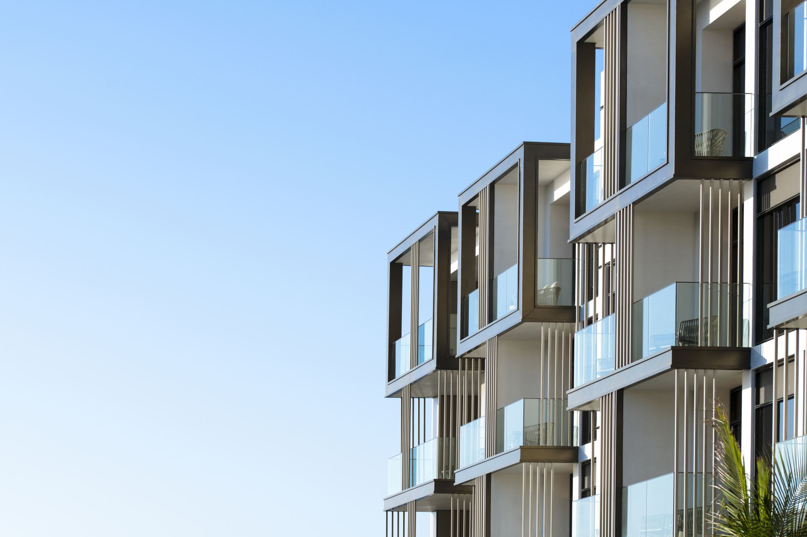
Why Choose Our Website?
Our website offers a convenient platform for people looking to sublet their apartment or find a sublet. Nowadays, sublets are mainly advertised in Facebook groups, and there's a lack of a convenient platform in Israel for sublet searches or postings.
Our system is designed to serve as a comprehensive sublet platform, allowing users to seamlessly search for available sublets or list their own apartments for sublet. Where users can easily browse listings, apply filters to refine searches, and make reservations with just a click.

Slide 4

Functional Requirements
Functionality- Subtenant:
User registration and login- enable users to
create an account and access the system
seamlessly.
Apartment search for sublet- allows users
to conduct an advanced search based on
criteria such as location, price range,
rating, etc.
View/edit profile.
Rating an apartment.
Reserve an apartment.
Cancel apartment reservation.
Functionality- Landlord:
User registration and login- enable users to create an account and access the system seamlessly.
View/edit profile.
Listing an apartment- adding photo, etc.
Remove apartment.

Slide 5

Non-Functional Requirements
Subtenant:
Retrieving search results, based on the DB.
Global:
Username Validation- username and password are injective, unable to choose username if it's already saved in the system.

Slide 6
Diagrams

Slide 7
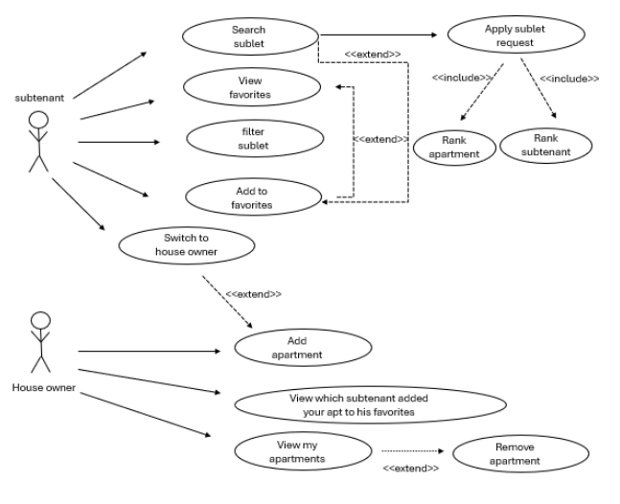
Uses Cases Diagram

Slide 8
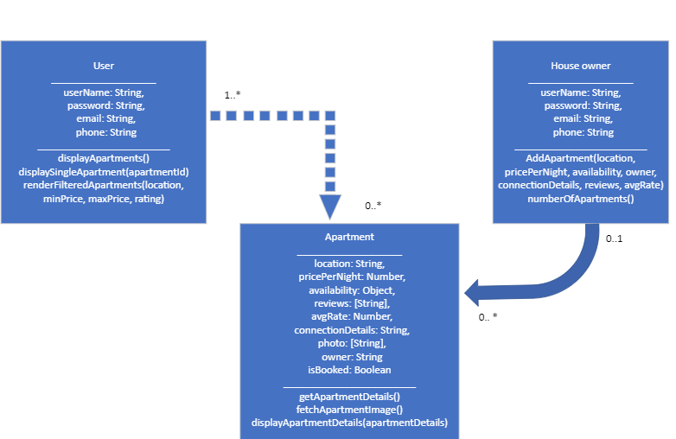
Class Diagram

Slide 9
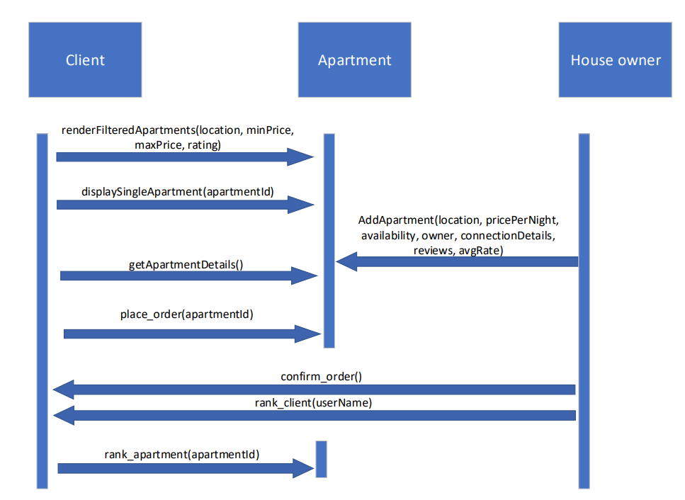
Sequence Diagram

Slide 10
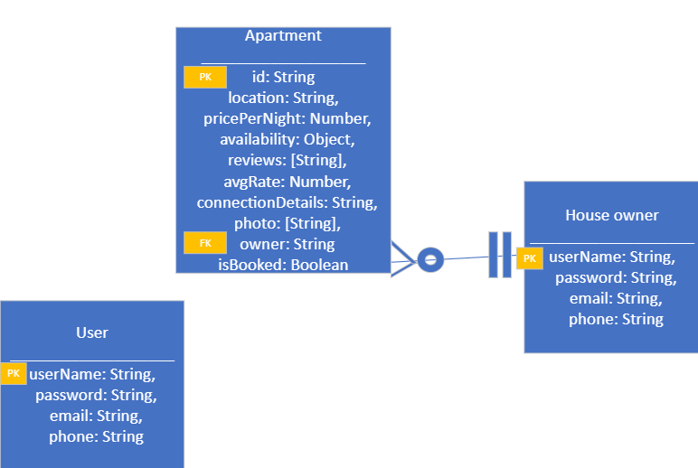
ERD

Slide 11
Object Diagram
Sub1 : Subtenant
-----------------------------------------
Name = Avi Levi
Email = avi@gmail.com
Phone number = 0547368827
Sub1 : House Owner
-----------------------------------------
Name = Avi Levi
Email = avi@gmail.com
Phone number = 0547368827
apt1 : Apartment
-----------------------------------------
Location = New York
Price = 120$
Availability = 12.11.2024-20.11.2024
Reviews = cozy
Average Rate = 4.8
Contact Details = 039674256
IsBooked = false

Slide 12
The System’s Structure
Server
Database
Classes- apartment, etc.

Slide 13

The System’s Functionality
Registration: Any individual can register for the system.
User Roles: Upon connecting to the system, users are classified as apartment seekers (subtenant) by default.
Apartment Ownership: Users can become apartment owners by adding their apartment to the advertisements.
Search and Interaction: Apartment seekers have various features such as advanced search, rating, writing recommendations, adding to favorites, and placing sublet orders.
Booking and Confirmation: Upon booking an apartment, users receive an order confirmation message, and the apartment is removed from the list of available sublets.

Slide 14

Cancellation: If an order is canceled, a confirmation message is displayed, and the apartment is reinstated into the list of available sublets.
Apartment Owner Actions: Apartment owners have privileges such as adding, deleting apartments, and viewing details of users who placed orders for their apartments.
Owner Actions: Apartment owners can add or delete apartments and view user details from whom they received an apartment order.
Filtering: Owners have the option to filter their apartments to view only those that are booked or available.
Profile Management: Each user can access and edit their user details on the profile page, as well as view their favorites list.

Slide 15

Features And System Overview

Slide 16
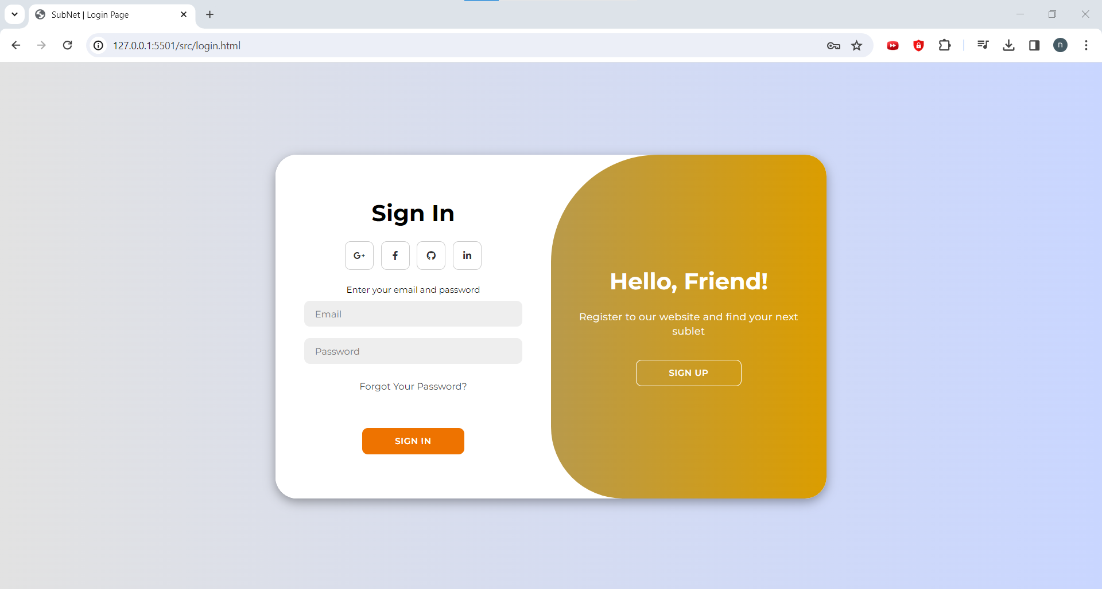
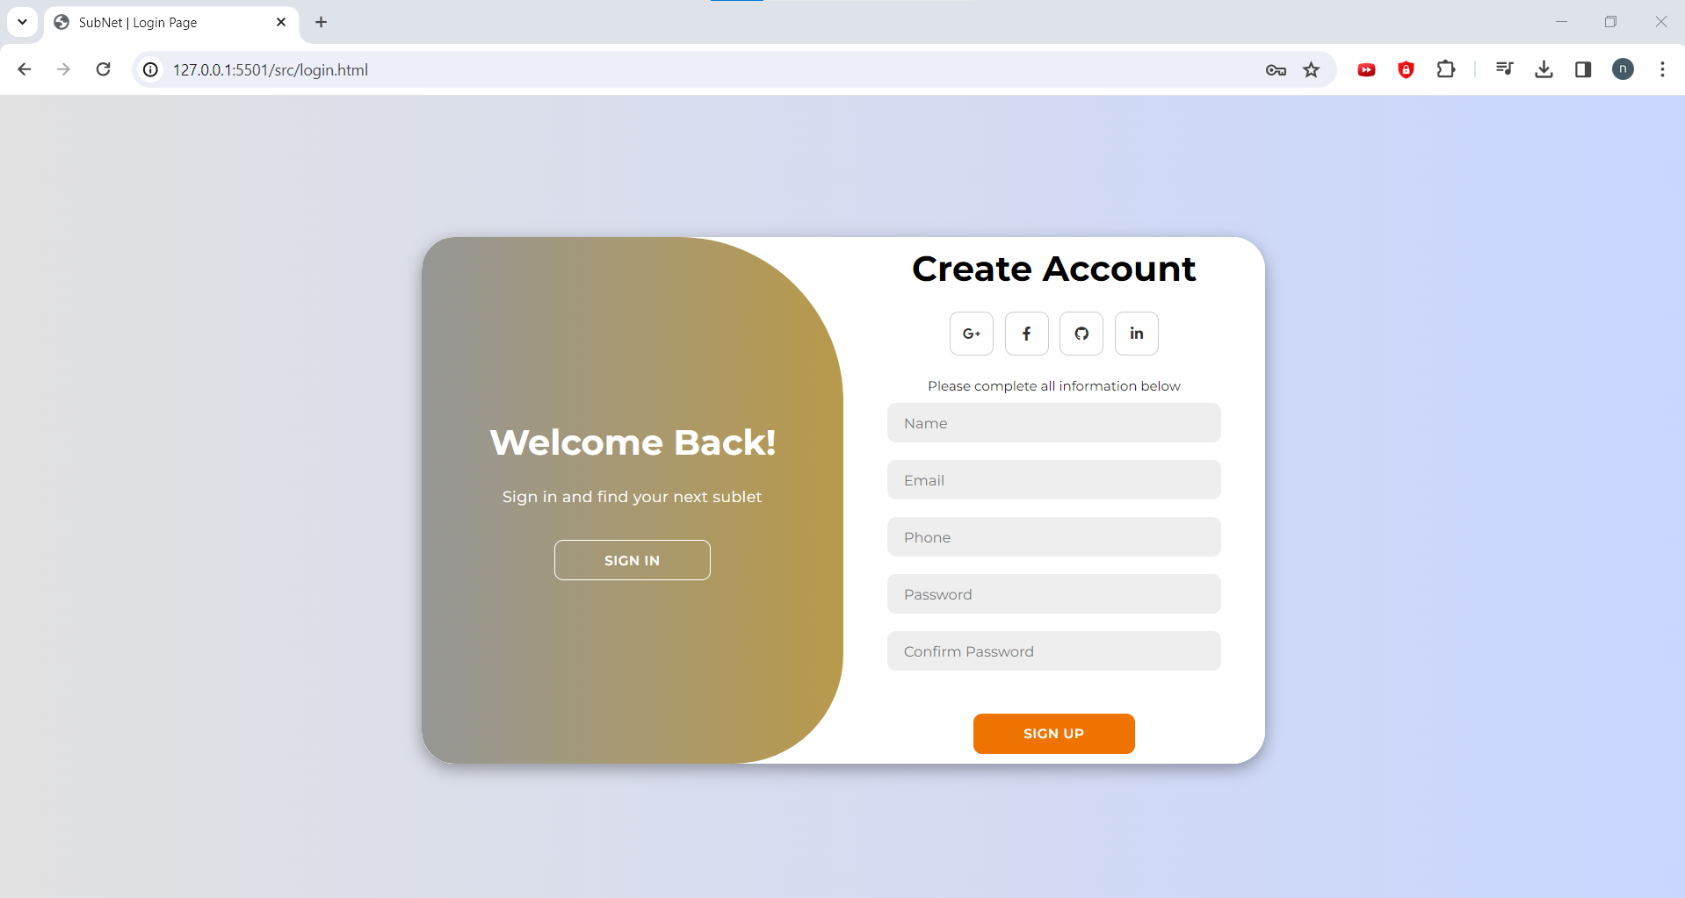
Login Page
Sign In
Sign Up

Slide 17
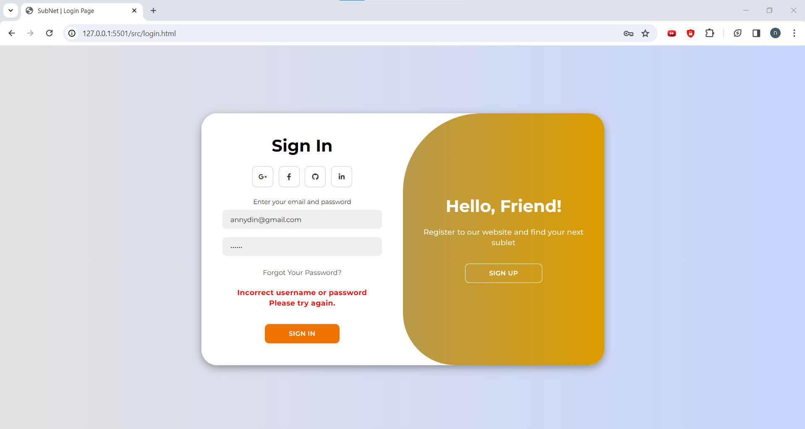
In case of incorrect username or password

Slide 18
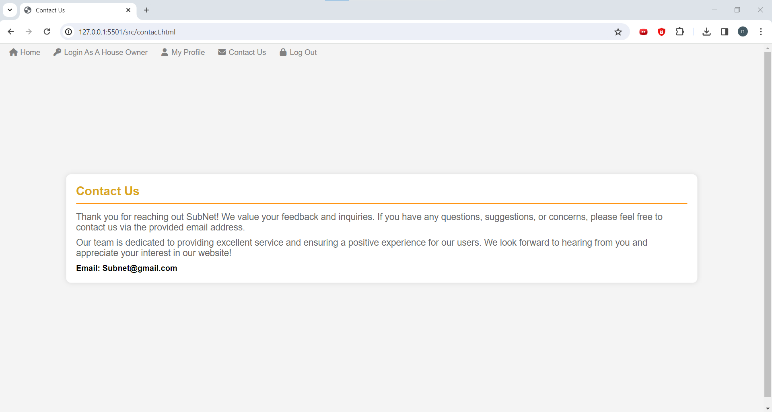
Contact Us Page

Slide 19
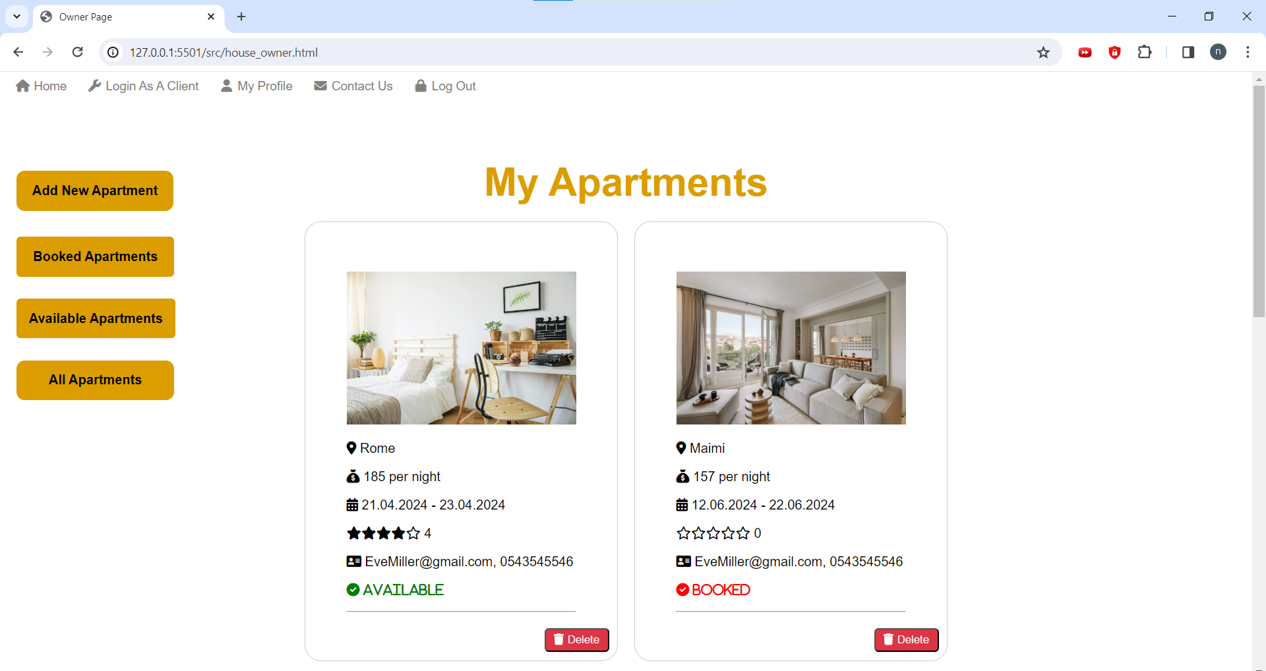
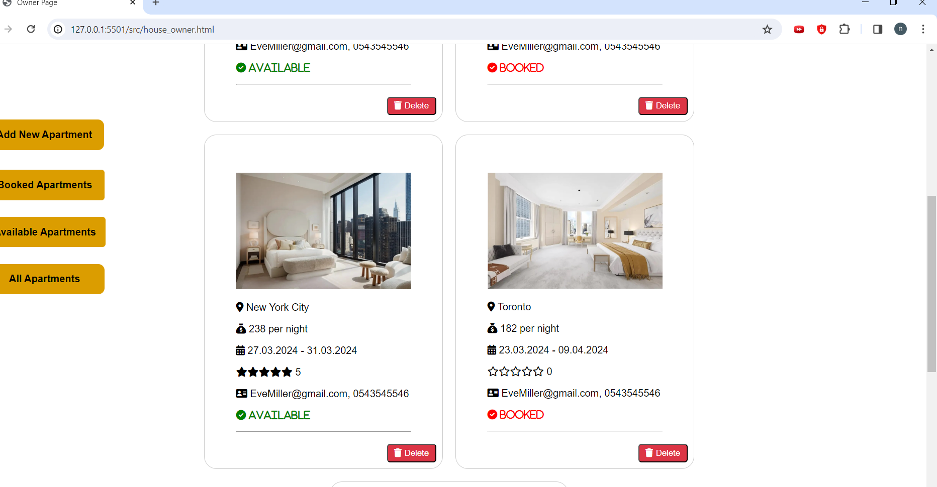
House Owner Page
A house owner can see his apartments for sublet and their status- booked or available.
Known as, login as a house owner, on the website menu.

Slide 20
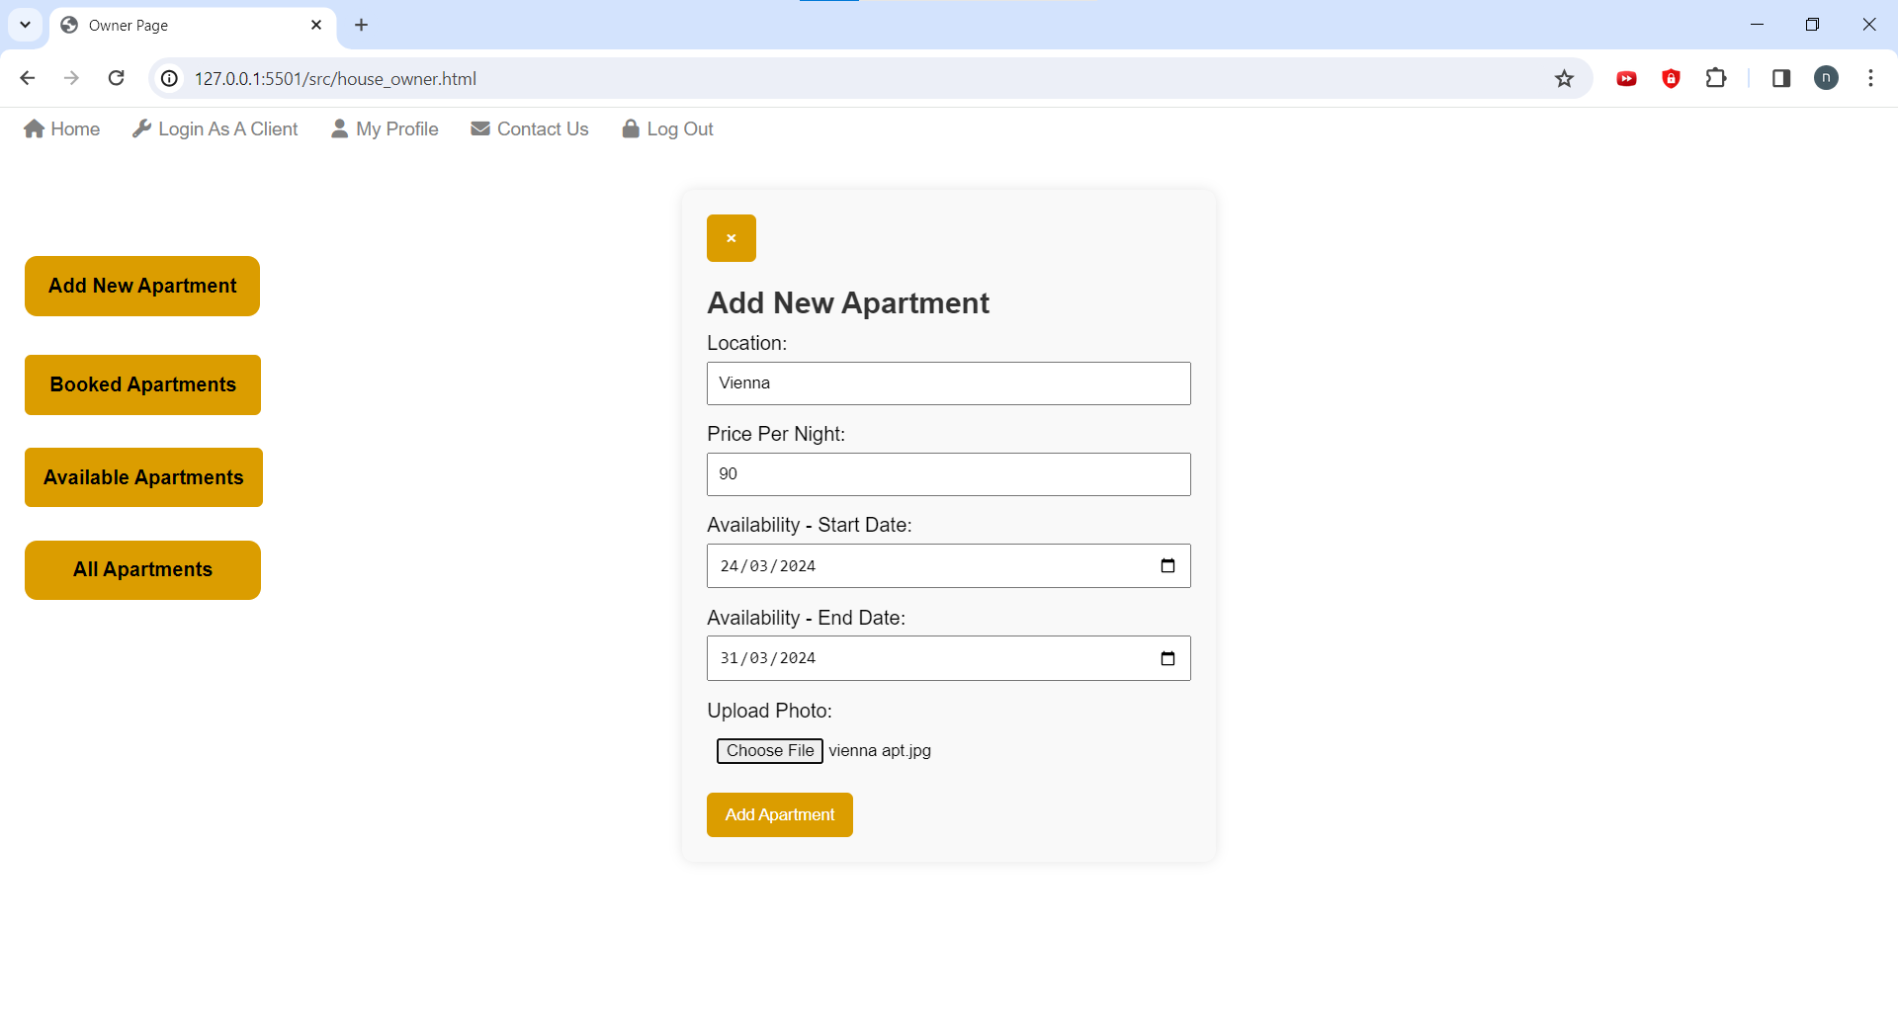
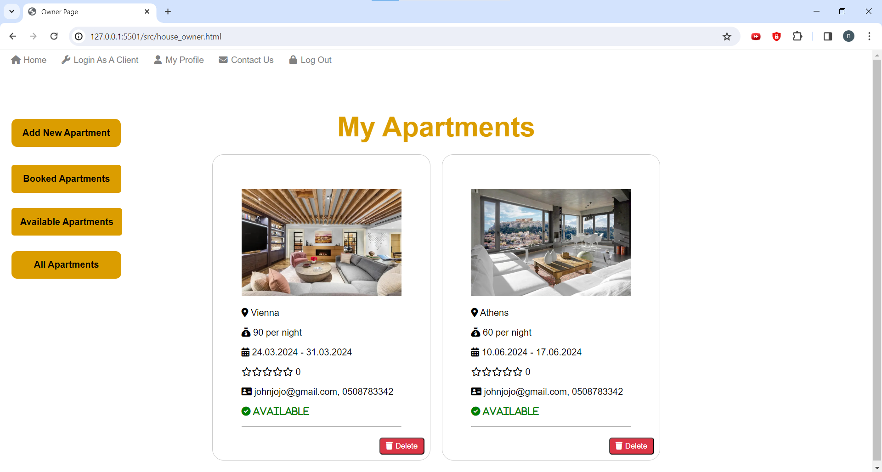
Apartment was added
Add new apartment

Slide 21
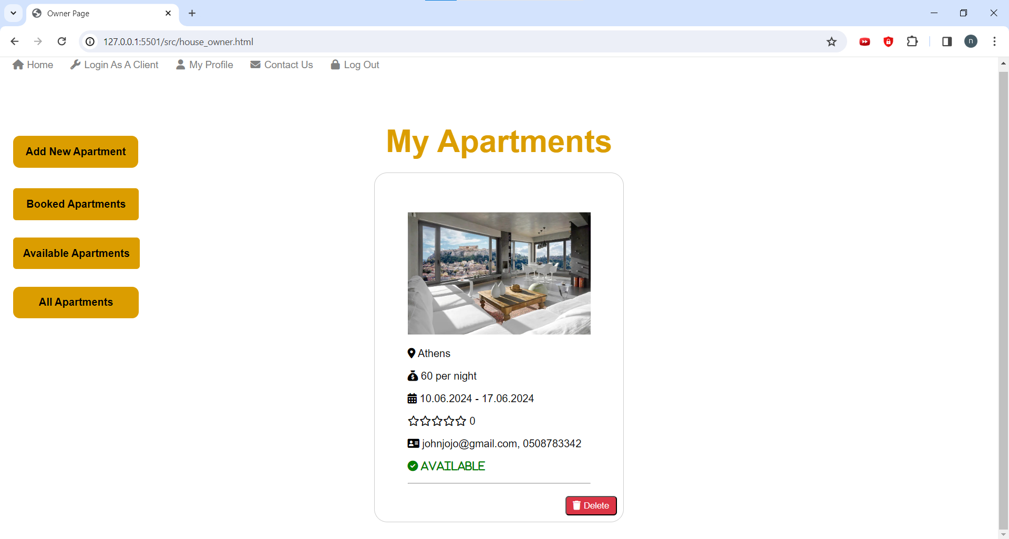
Delete apartment-
When clicking the Delete button the apartment is deleted and will not be shown in the listed apartments.
Before
After

Slide 22
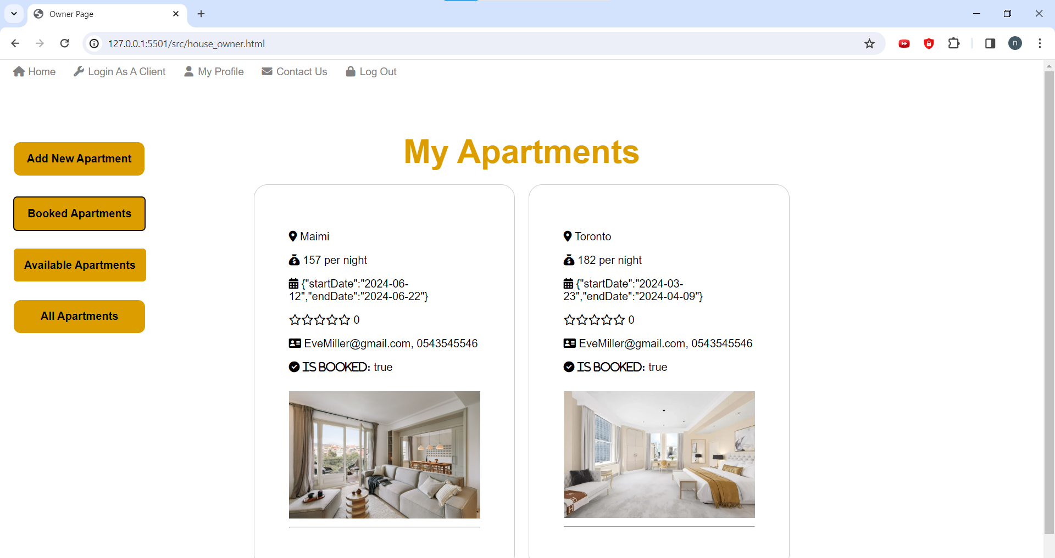
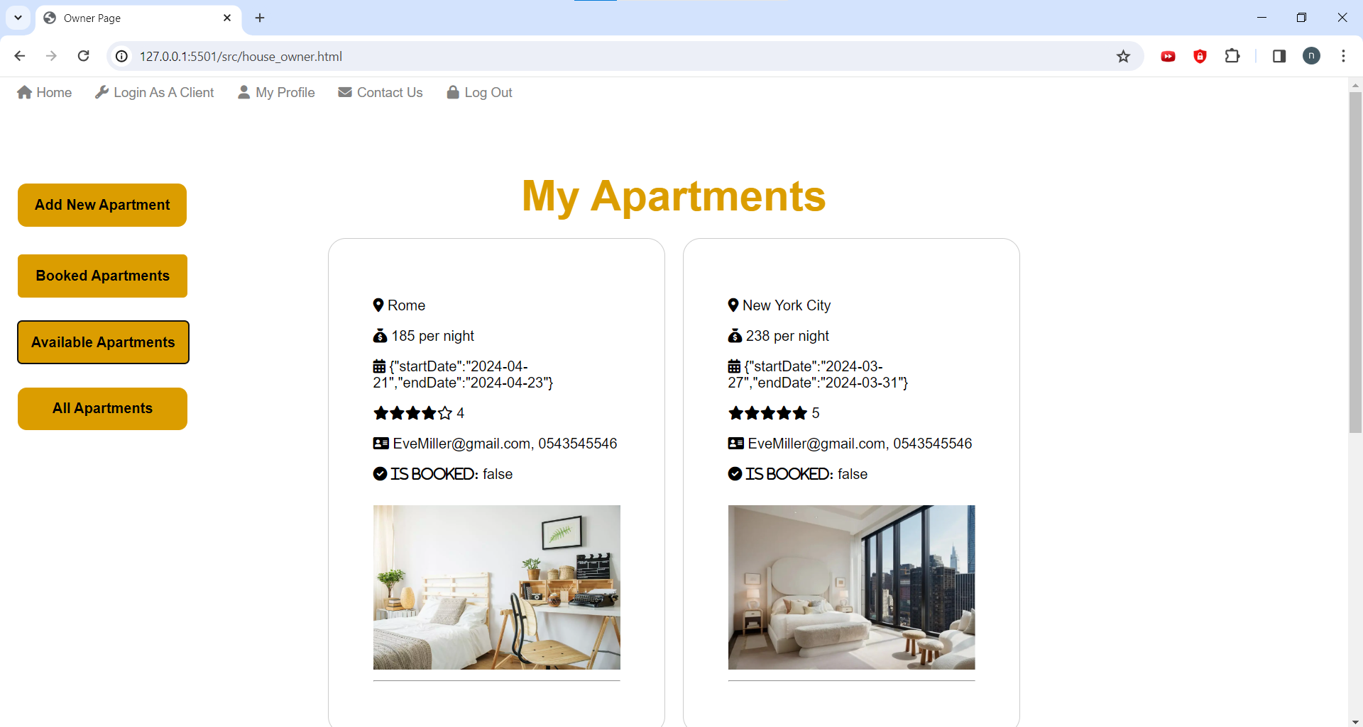
Booked apartments filter
Available apartments filter

Slide 23
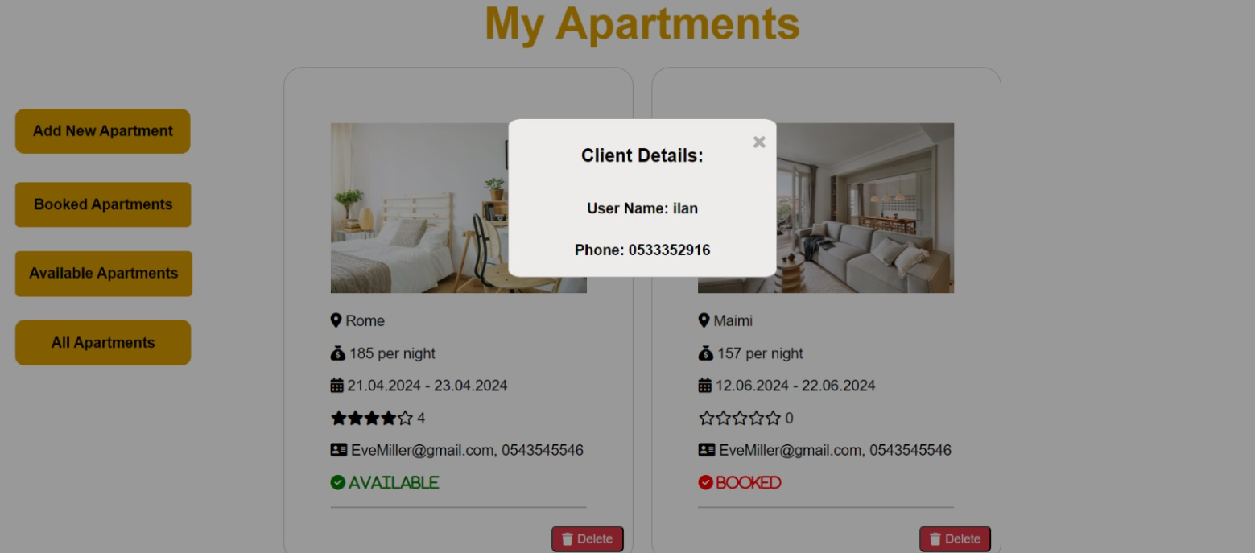
When clicking on the apartment a popping window displays the username and the phone number of the person who booked the apartment (subtenant)

Slide 24
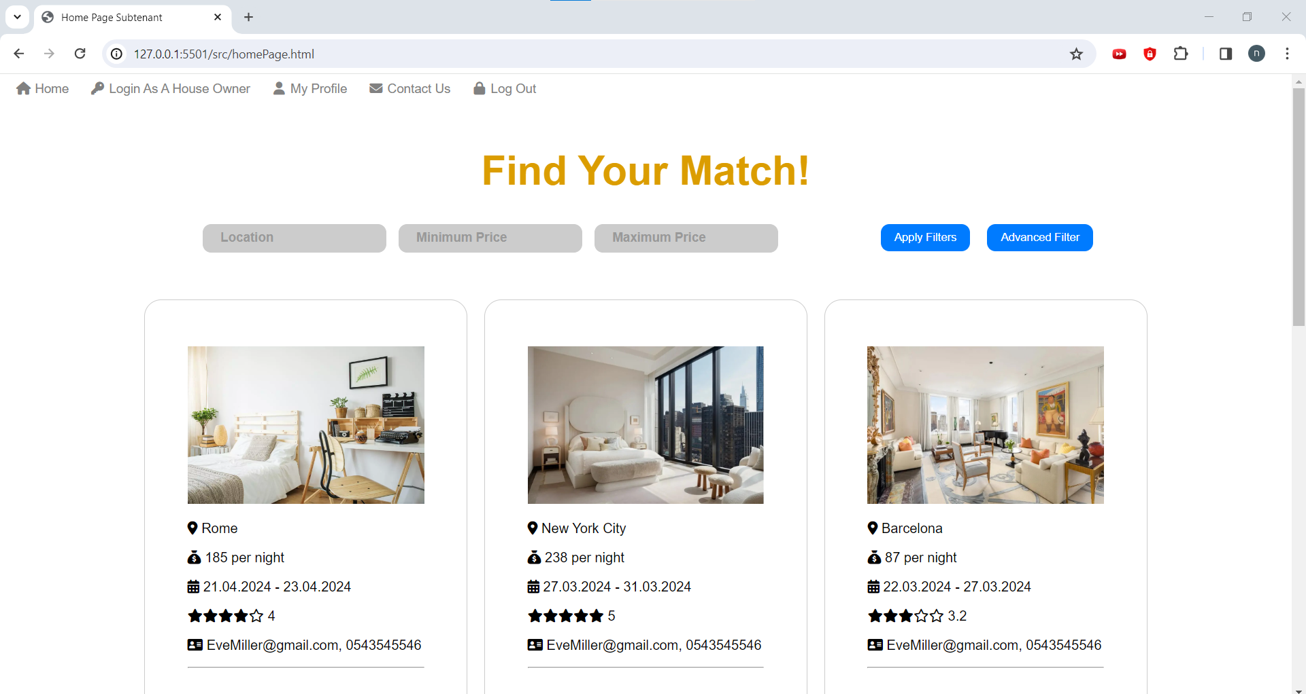
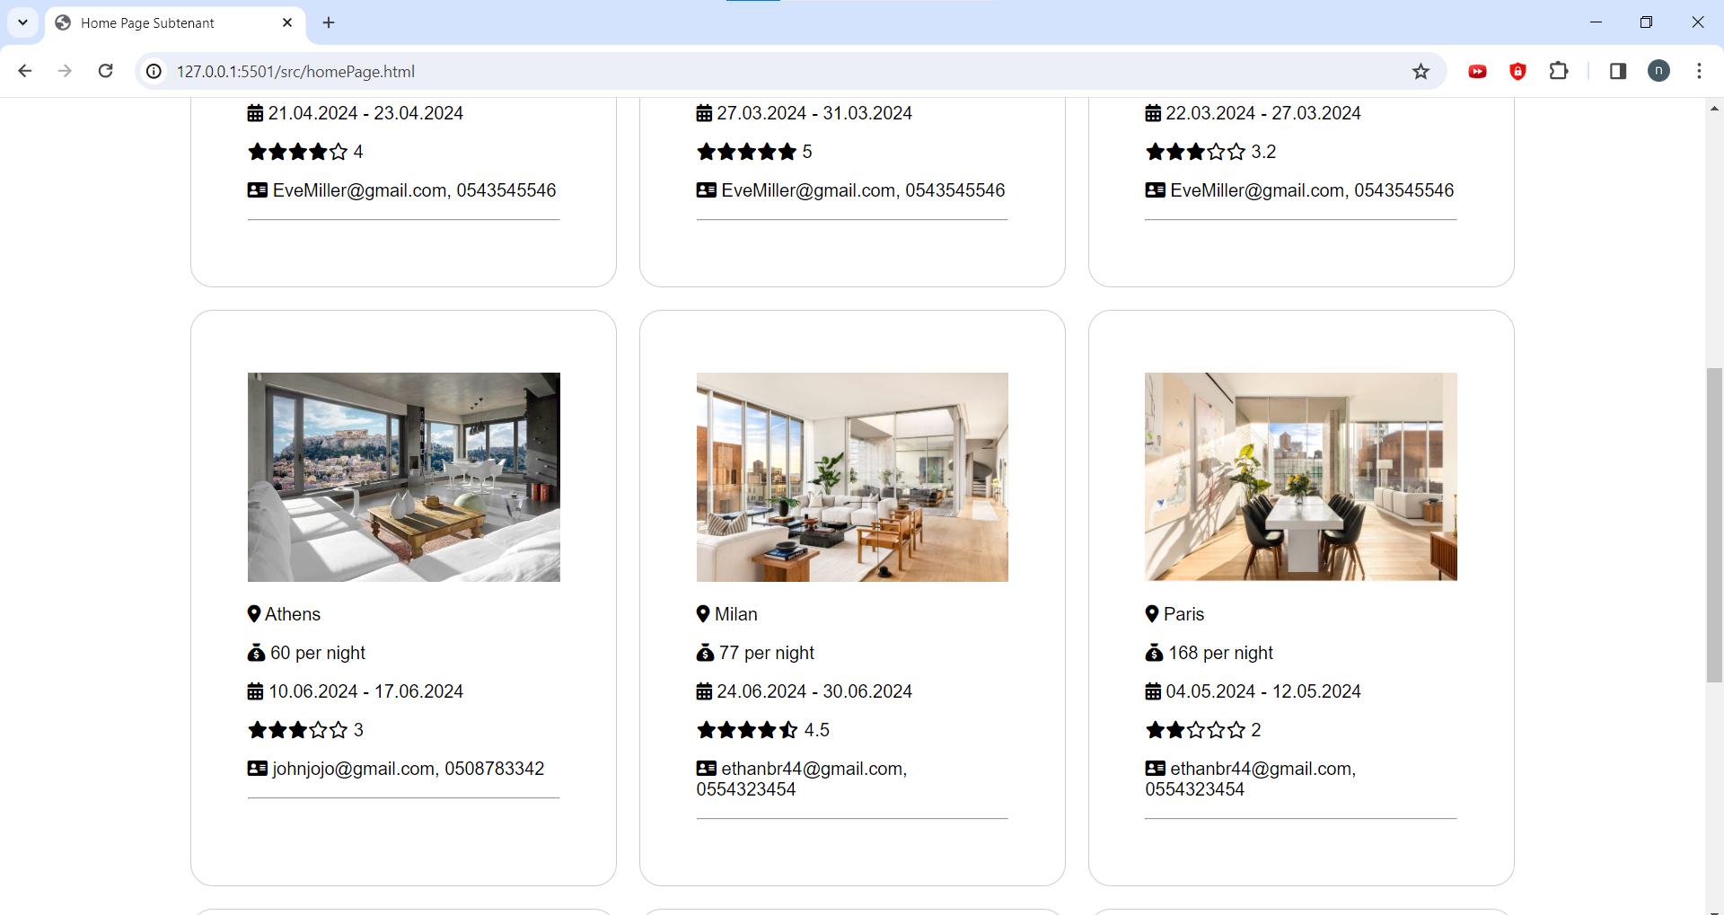
Home Page
An apartment seeker can see available apartments for sublet.

Slide 25
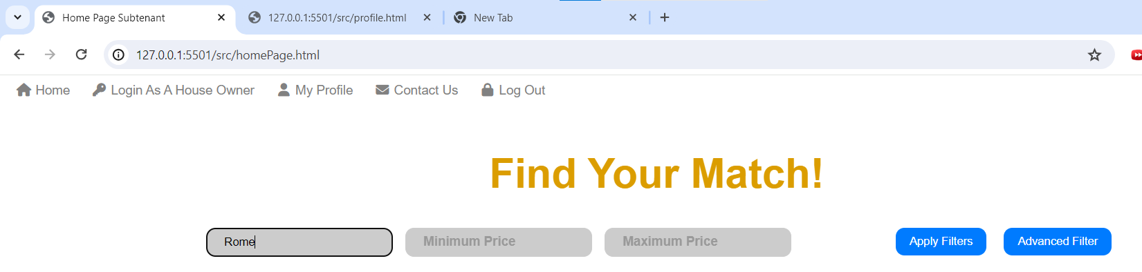
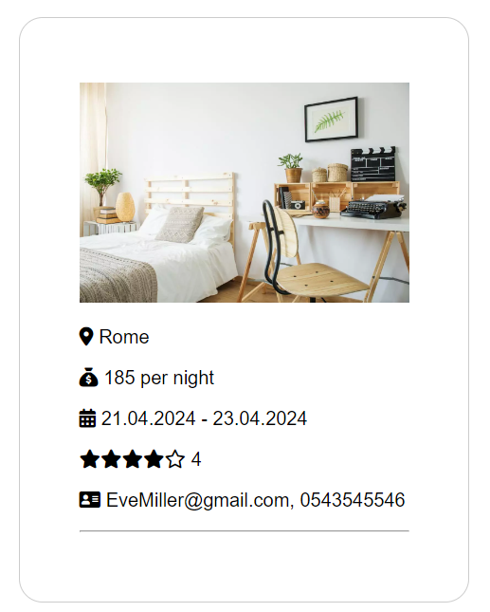
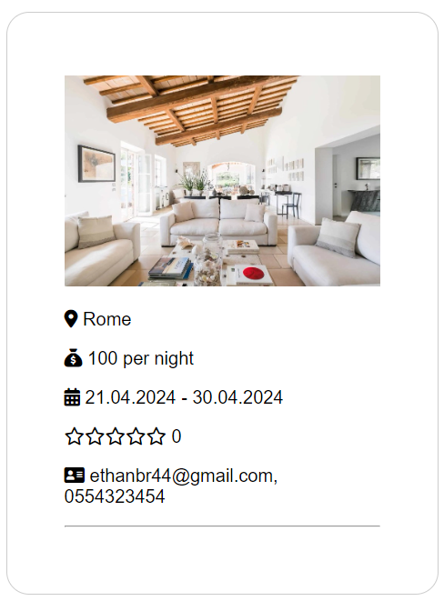
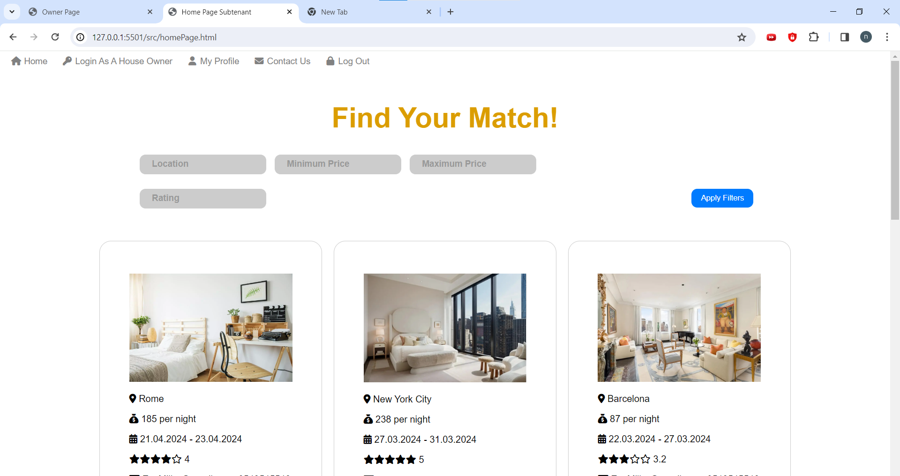
After filter
Advanced filter

Slide 26
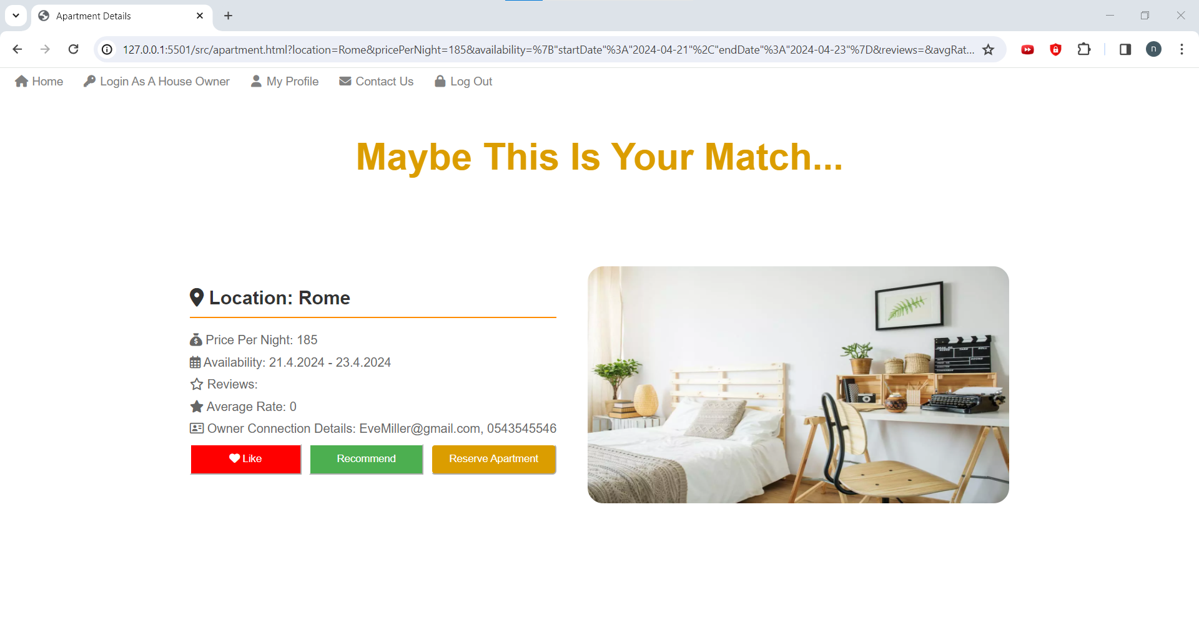
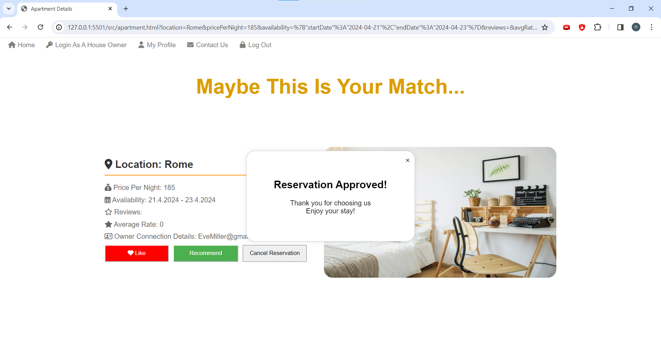
Apartment Page
Reserve apartment by clicking the “Reserve Apartment button”

Slide 27
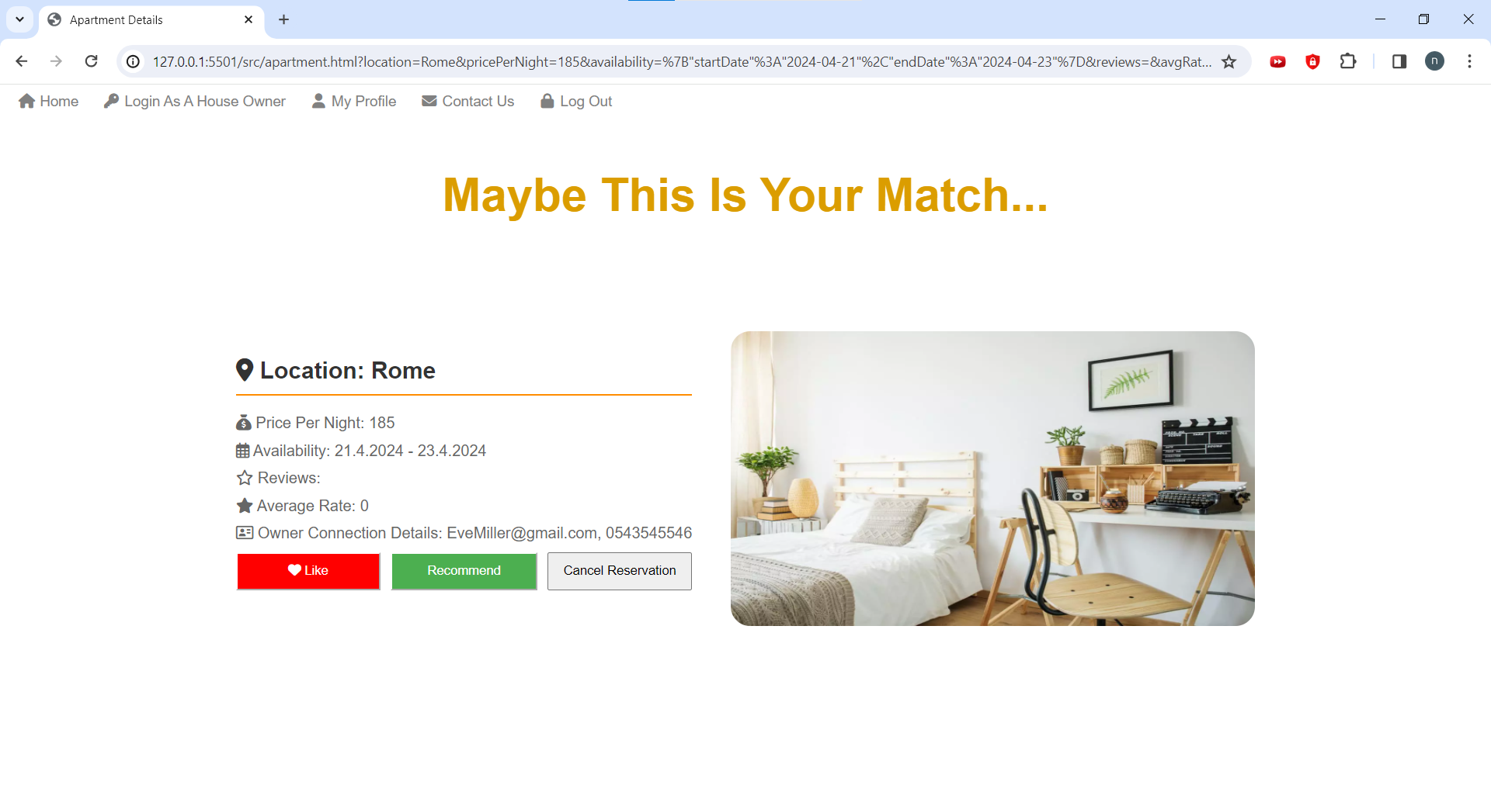
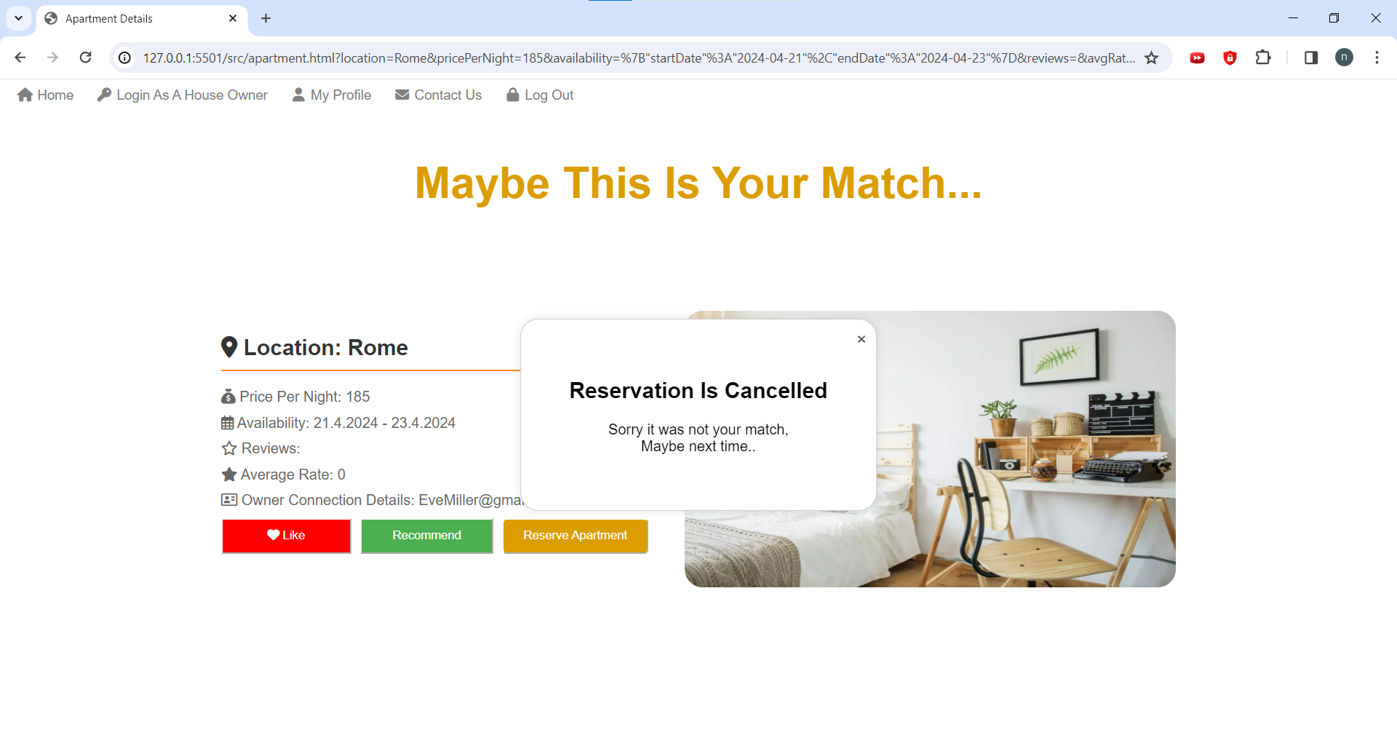
Delete apartment by clicking the “Delete Apartment button”

Slide 28
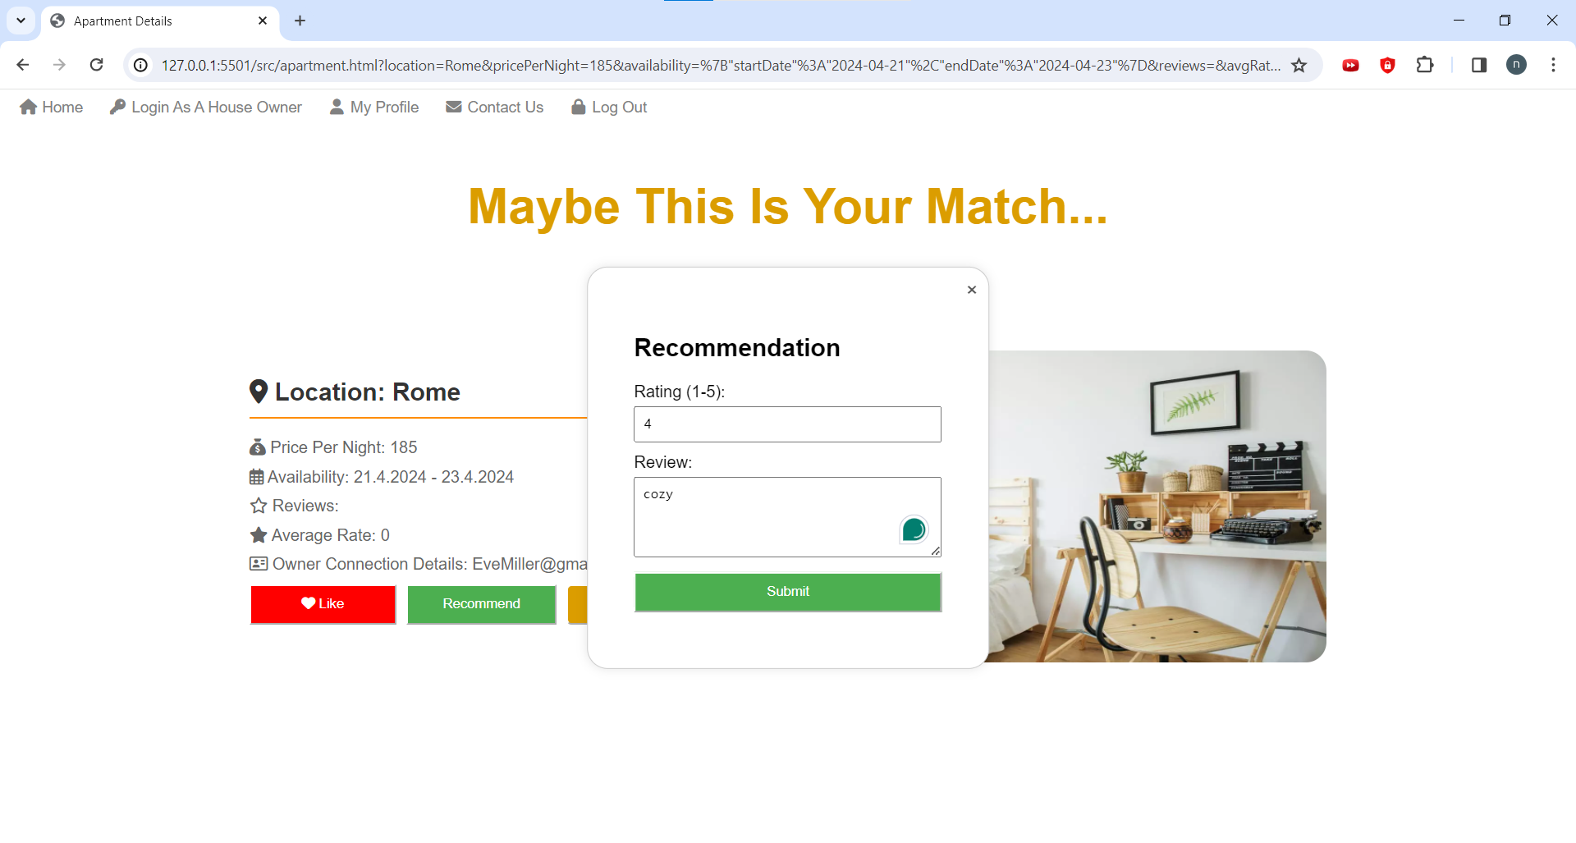
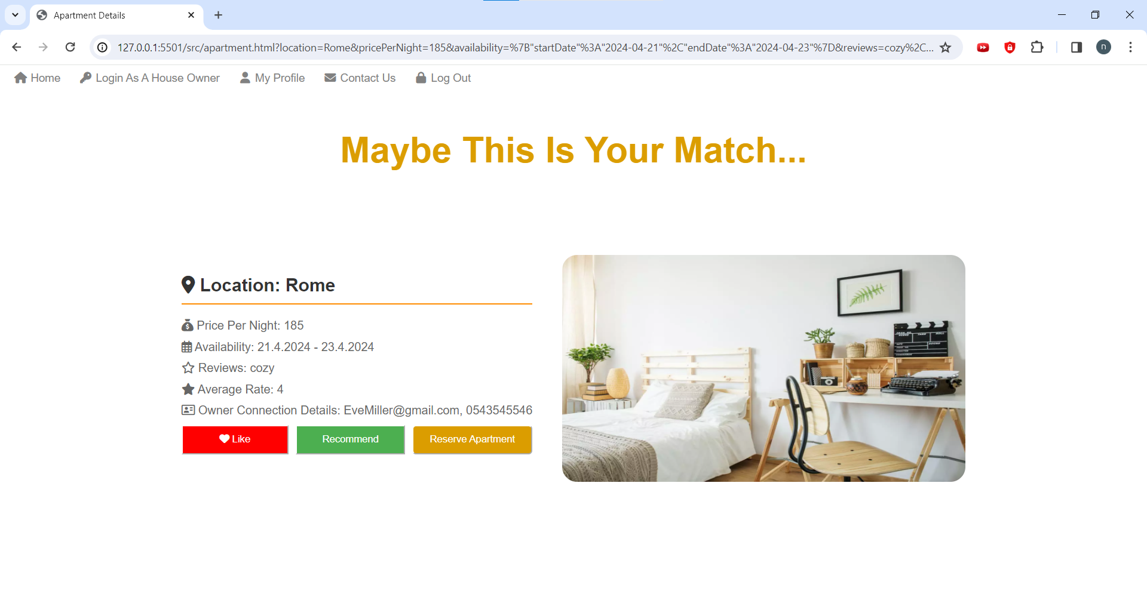
Add a recommendation
Recommendation was added

Slide 29
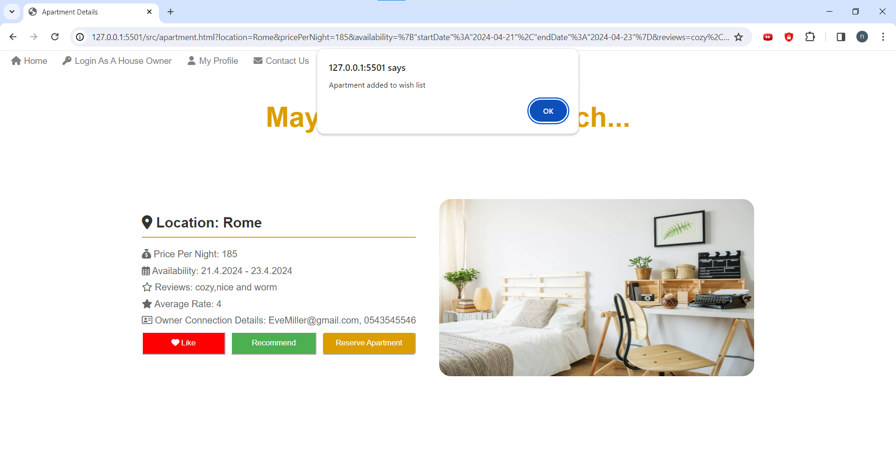
After clicking the like button

Slide 30
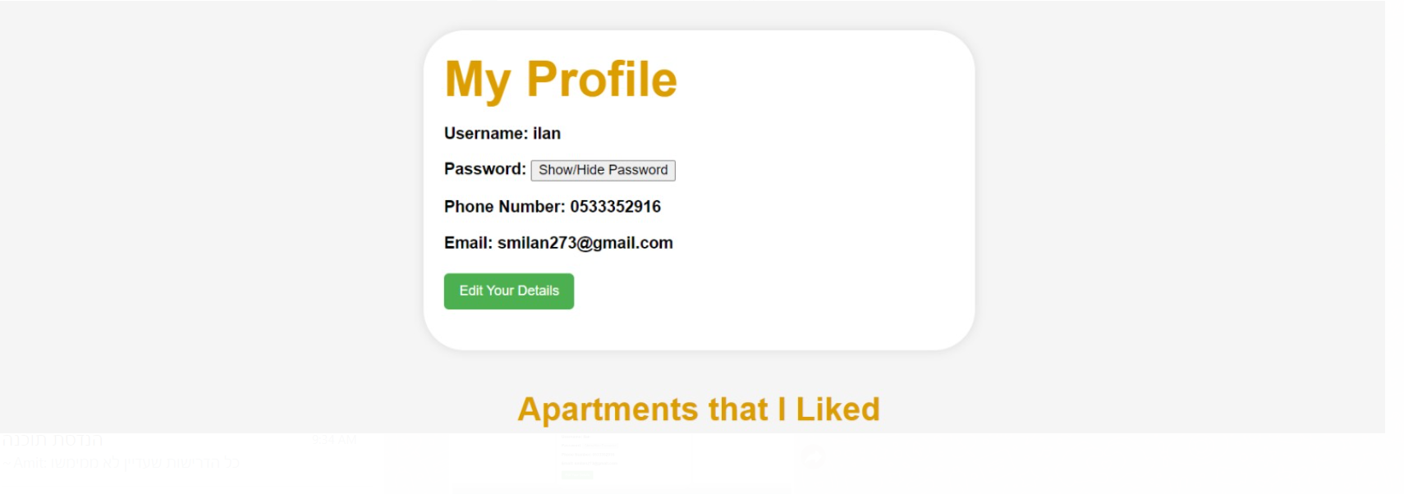
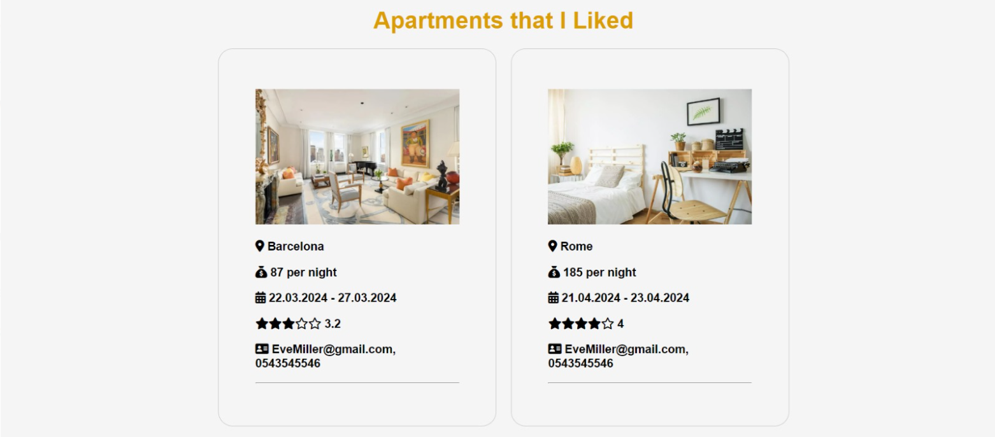
Profile Page

Slide 31

Incomplete Due to Time Constraints
Edit apartment advertisement
Chat between subtenant and landlord
Notify house owner (by a popping notification) when a client reserves an apartment
A reminder, a day before the sublet starts send a notification to the subtenant

Slide 32
The End!

